Slide 1
Group 1: Communication System

Slide 2
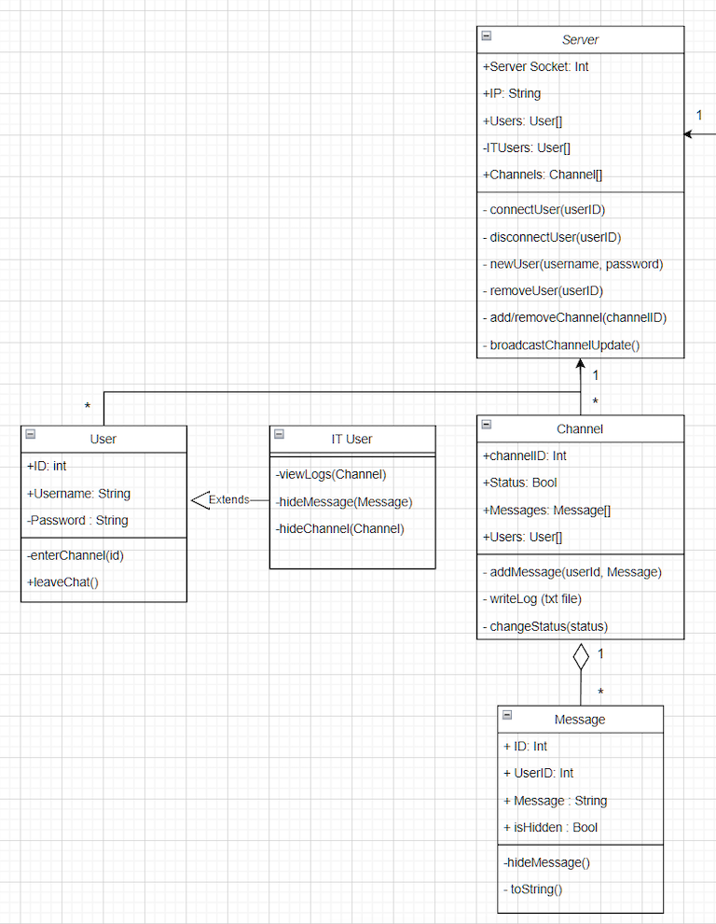
Class diagram: Server

Slide 3
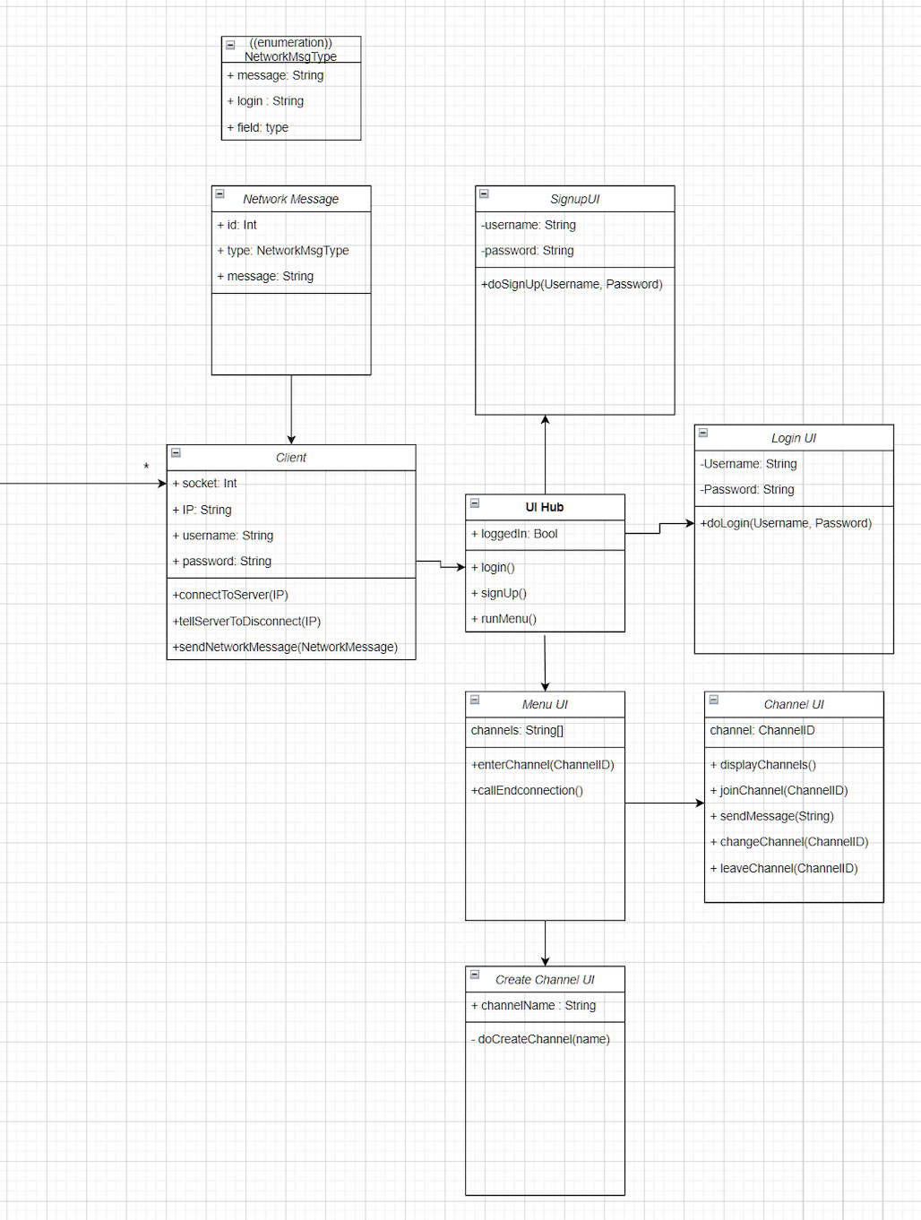
Class diagram: Client

Slide 4
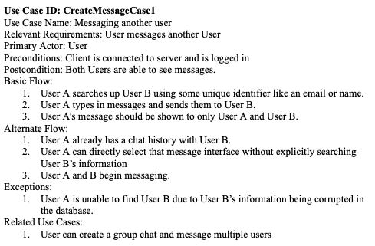
Use Case Example:

Slide 5
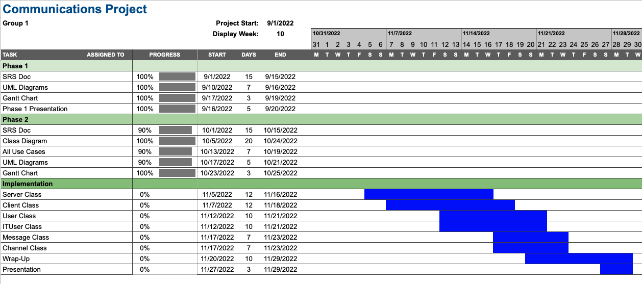
Gantt Chart & Scheduling
Meeting Times: Thursdays 2-3pm, Fridays 10am-12pm
Where: Discord

